Slide 1
Reinforcement Communication Learning in Different Social Network Structures
Marina Dubova, Arseny Moskvichev, Robert L. Goldstone

Slide 2
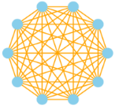
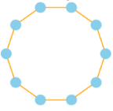
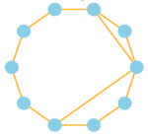
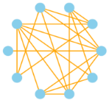
Introduction and Set-Up
Motivation: Word conventions in human languages are affected by the social topology
Experiment: Assess the influence of different topologies using MARL emergent languages
Game set-up:
10 Agents, Coordination Game, 4 possible messages, 4 possible actions
Social network types:
a) Fully connected (clique)
b) Ring
c) Small-world
d) Random

Slide 3
Metrics
Speaking and Listening Consistency: Do the chosen actions depend on the signal?
Communication Asymmetry metrics: Different communication patterns between agents ?
Between-agent signal-action mapping divergence: Dictionaries similar for different agents?
Within-agent signal-action mapping divergence: Difference between “speaker” and “listener” dictionaries?
Talking divergence: Different Agents = Different communication patterns?
Behavioural Predictability: How uniform do agents look-up words? How uniform are the actions based on the received signal?

Slide 4
Experiment 1: Social Network Types :
They found that the global connectivity of a social network plays a crucial role in driving the convergence of populations on shared and symmetric communication systems.
This prevents the agents from forming many local "dialects".
Additionally, the degree of an agent in the network is inversely related to the consistency of its use of communicative conventions.

Slide 5
Experiment 2: Average Degree and Speaker Consistency
The average degree of a social network has a negative effect on both speaker and listener consistencies. As the average degree increases, the consistencies decrease
Experiment 3: Effect of Global Connections
The results showed that high local connectivity led to the emergence of local communication patterns within the population, while more global connections forced agents to find global consensus.

Slide 6
Summary:
In this scientific article, the researchers investigated the impact of social network structure on the development of communication systems in decentralized, multi-agent reinforcement learning communities. They found that the global connectivity of a social network plays a crucial role in driving the convergence of populations on shared and symmetric communication systems. This prevents the agents from forming many local "dialects". Additionally, the degree of an agent in the network is inversely related to the consistency of its use of communicative conventions.
Future Scope:
1. Explore the impact of different social network structures on the properties of communication systems emerging in decentralized multi-agent reinforcement learning communities.
2. Investigate the role of social network connectivity on the convergence of populations on shared communication systems.

